Slide 1
Three methods to create 3D models

Slide 2
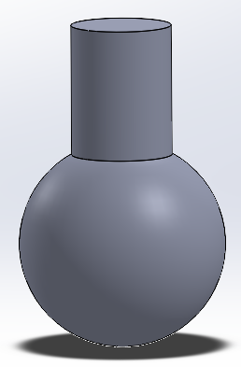
Primitive method
In the method, any 3D model was divided into several simple, basic, standard of items, such as blocks, cylinders, spheres, cones, etc. which usually integrated in CAD system as a standard body. Through these, user can decide how to combine different of them together to construct a new model, then using Boolean operations to get the final result.

Slide 3
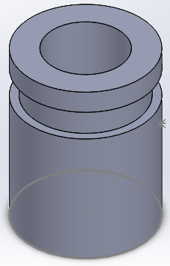
Feature method
Let user to utilize some predefined feature generating instruments, like groove, hole, slot, boss, pad, etc. to simulate a real manufacturing process to create some structure from a simple basic body.

Slide 4
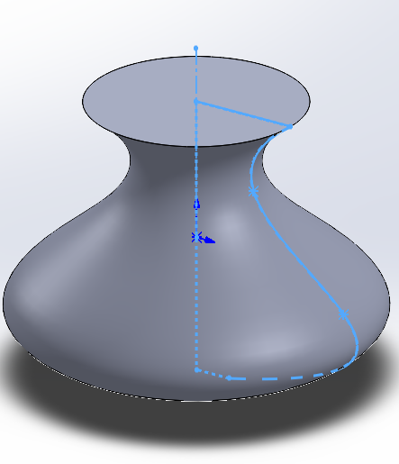
Sketch method
The main idea of this approach is to create 3D body by 2D sketch. Taking use of extrusion, revolution algorithms, in addition some of basic Boolean operations, use can create a very complex 3D structures.
This method is the most popular way used by most of commercial CAD softwares including Solidworks.

Slide 5
Sketch method
The main steps of sketch method to create 3D models are
Define a sketch plane as cross section;
Sketch 2D shapes on the cross section;
Constraint 2D shapes with accurate dimensions;
Perform 2D to 3D operations.

